Slide 1
Chat GPT, and AI applications
by Ahmed Nabil Mahran
19/02/2023

Slide 2
Agenda
About Me
What is GPT3
What is Chat GPT
How was it developed
How to Use it
Live examples
Other AI applications
What's next, use Open AI API.
Q/A

Slide 3
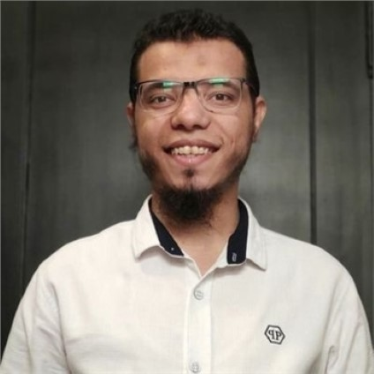
Ahmed Nabil
Software Technical Lead at Vodafone Germany.
Coding since I was 11 years old.
~ 10 years of Mobile App Development.
Worked at Hungerstation ( Delivery Hero ) , Codly, Gen C. And others.
Built large-scale apps with 10M+ downloads.
Founder and Leader of Kotlin Egypt
Public speaker, Tech. Youtuber and writer.
helped more than 100K people know about Kotlin and Android.

Slide 4
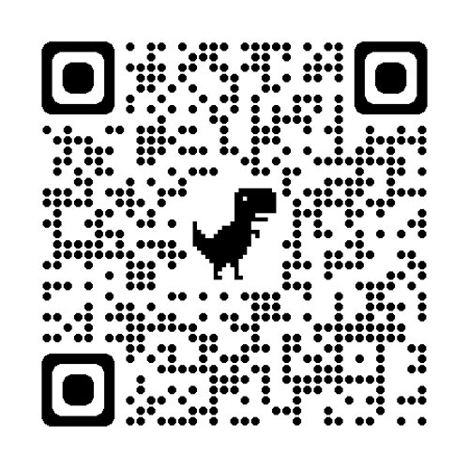
Check all my links and content
Https://Youtube.com/AhmedNMahran/About

Slide 5
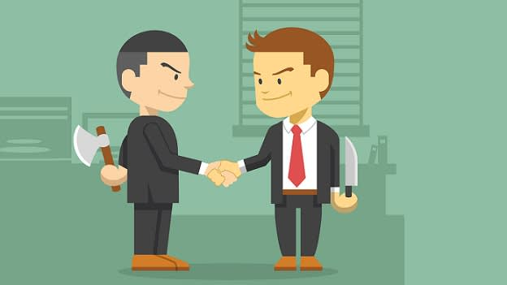
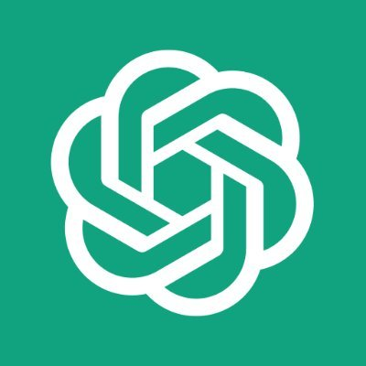
image from: https://www.peoplematters.in/article/watercooler/frenemy-5-ways-to-make-your-work-enemy-your-friend-13652

Slide 6
What is GPT-3 ?

Slide 7
GPT-3
(Generative Pre-trained Transformer 3)
Language generation model by OpenAI
Produces human-like text
Trained on over 8 billion words

Slide 8
What is Chat GPT?

Slide 9
Chat GPT
GPT-3 variant
focusing on conversational AI applications
also trained on massive data set of words

Slide 10
Live Example

Slide 11
Start Using Chat GPT
Login with VPN
Enter your email
Enter a valid physical (not virtual phone number)
Enter the OTP
You can then use the service anytime, anywhere, without VPN.

Slide 12
Train your own models

Slide 13
Other AI tools

Slide 14
Other AI applications
Image generation (DALL-E)
DeepFake
AI Voice generation and voice enhancement
(Adobe Podcast)

Slide 15
Will AI replace us?

Slide 16
Thanks & Questions

Slide 17
Check all my links and content
Https://Youtube.com/AhmedNMahran/About

